Slide 1

Chapter 2
The OSI Model and the TCP/IP Protocol Suite
Copyright © The McGraw-Hill Companies, Inc. Permission required for reproduction or display.

Slide 2
Chapter Outline
2.1 Protocol Layers
2.2 The OSI Model
2.3 TCP/IP Protocol Suite
2.4 Addressing

Slide 3
2-2 THE OSI MODEL
Established in 1947, the International Standards Organization (ISO) is a multinational body dedicated to worldwide agreement on international standards. Almost three-fourths of countries in the world are represented in the ISO. An ISO standard that covers all aspects of network communications is the Open Systems Interconnection (OSI) model. It was first introduced in the late 1970s.

Slide 4
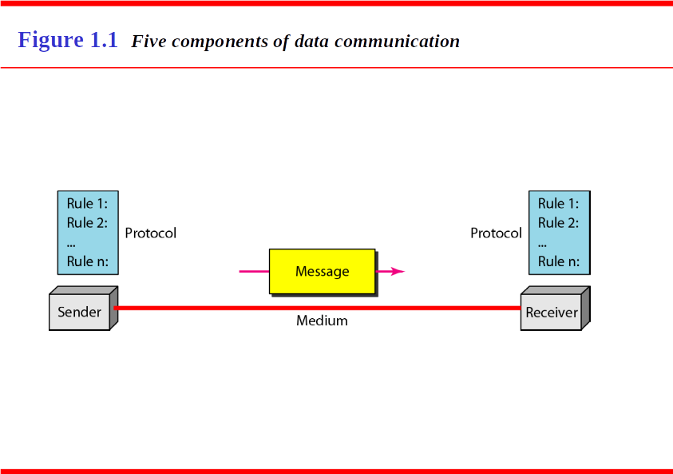

Slide 5
Topics Discussed in the Section
Layered Architecture
Layer-to-layer Communication
Encapsulation
Layers in the OSI Model
Summary of OSI Layers

Slide 6

Note
ISO is the organization;
OSI is the model.

Slide 7
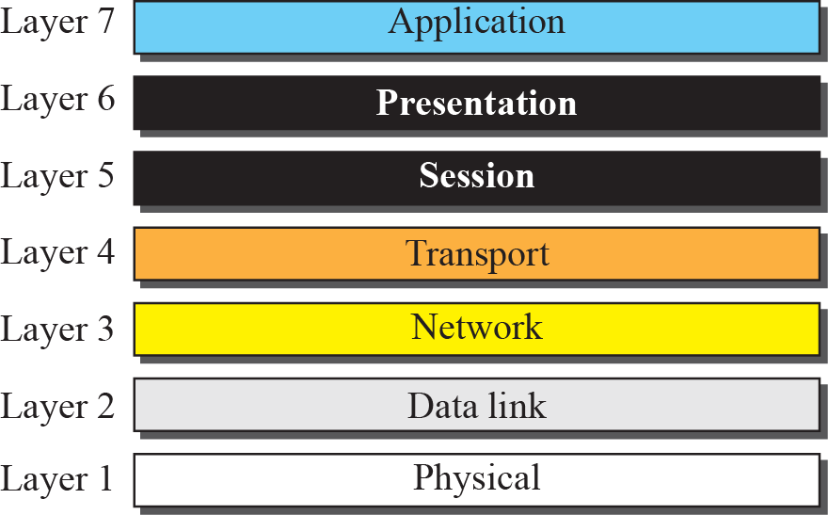
Figure 2.3 The OSI model

Slide 8

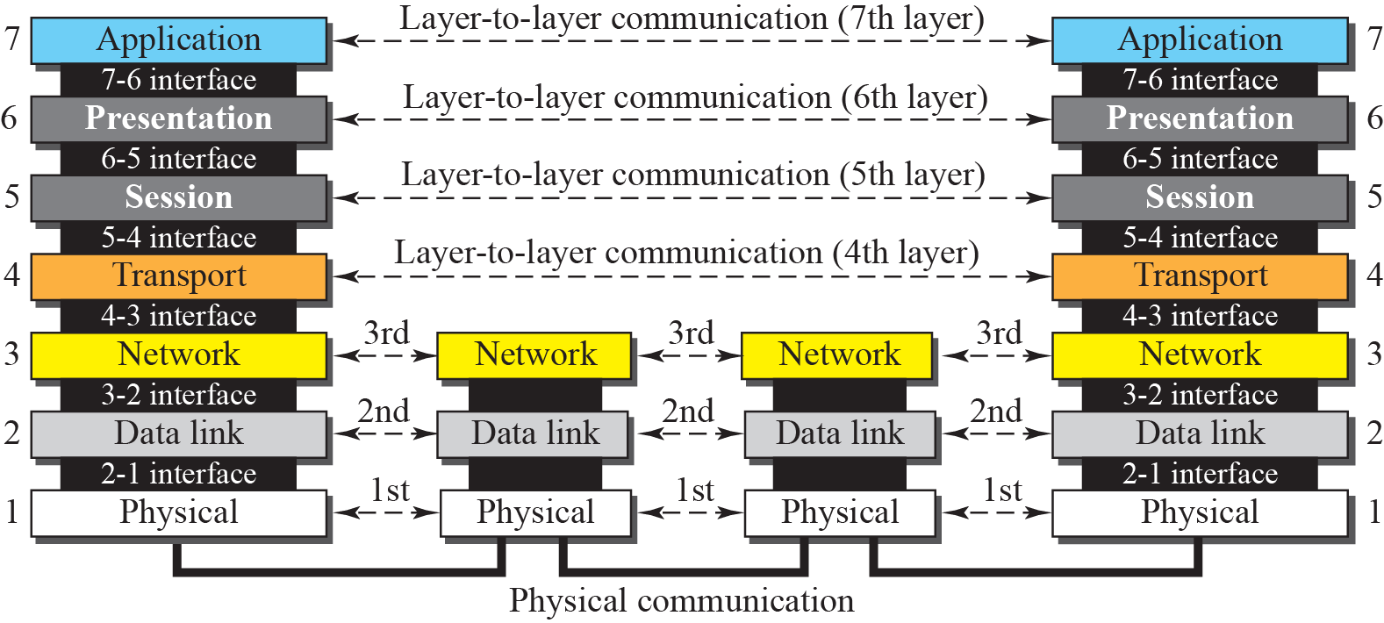
Figure 2.4 OSI layers

Slide 9
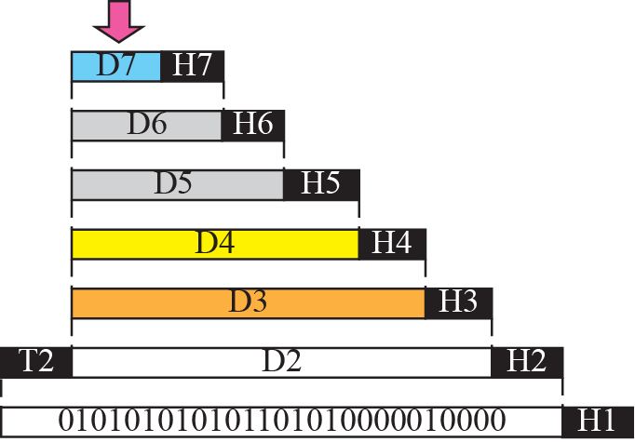


Figure 2.5 An exchange using the OSI model

Slide 10
Note
The physical layer is responsible for moving individual bits from one
(node) to the next.

Slide 11
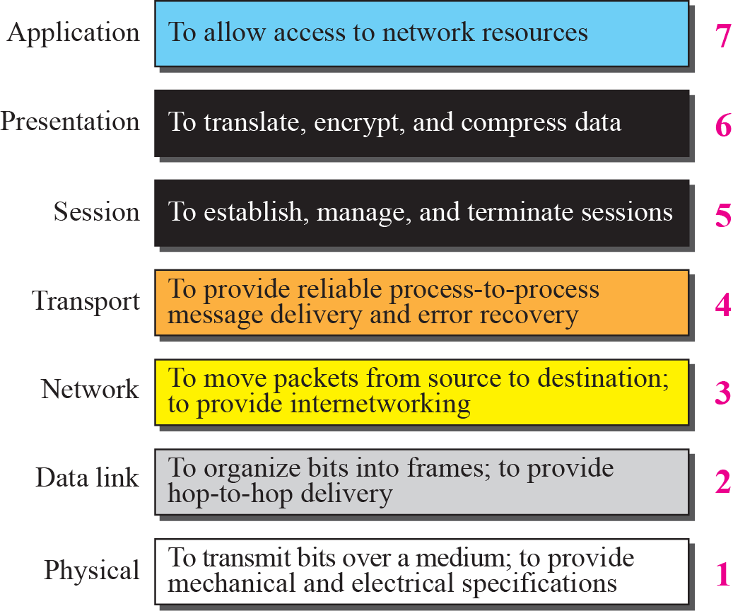
Figure 2.6 Summary of OSI Layers

Slide 12
2-3 TCP/IP PROTOCOL SUITE
The TCP/IP protocol suite was developed prior to the OSI model. Therefore, the layers in the TCP/IP protocol suite do not match exactly with those in the OSI model. The original TCP/IP protocol suite was defined as four software layers built upon the hardware. Today, however, TCP/IP is thought of as a five-layer model with the layers named similarly to the ones in the OSI model. Figure 2.7 shows both configurations.

Slide 13
Topics Discussed in the Section
Comparison between OSI and TCP/IP
Layers in the TCP/IP Suite

Slide 14
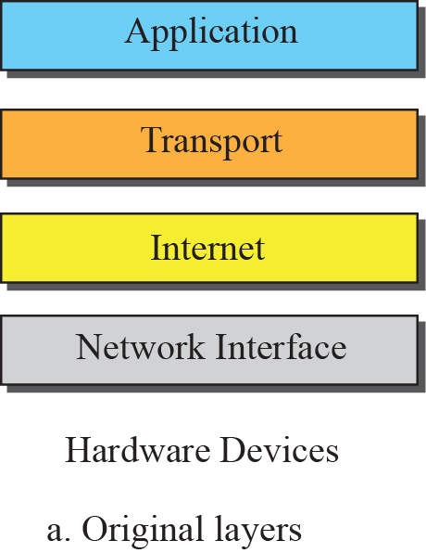
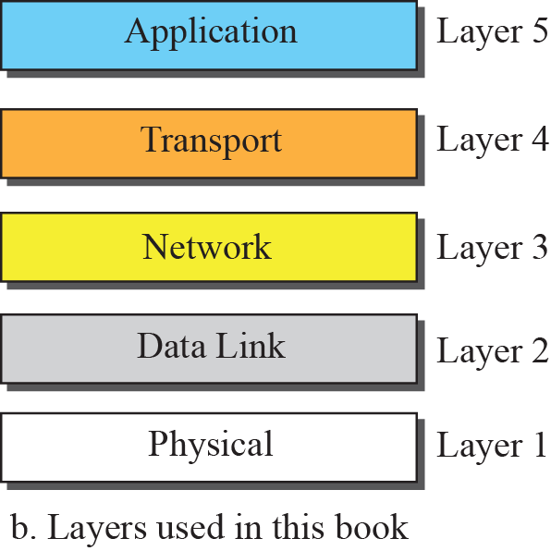

Figure 2.7 Layers in the TCP/IP Protocol Suite

Slide 15
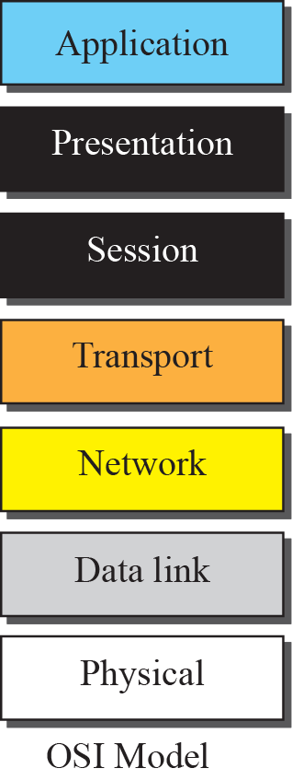
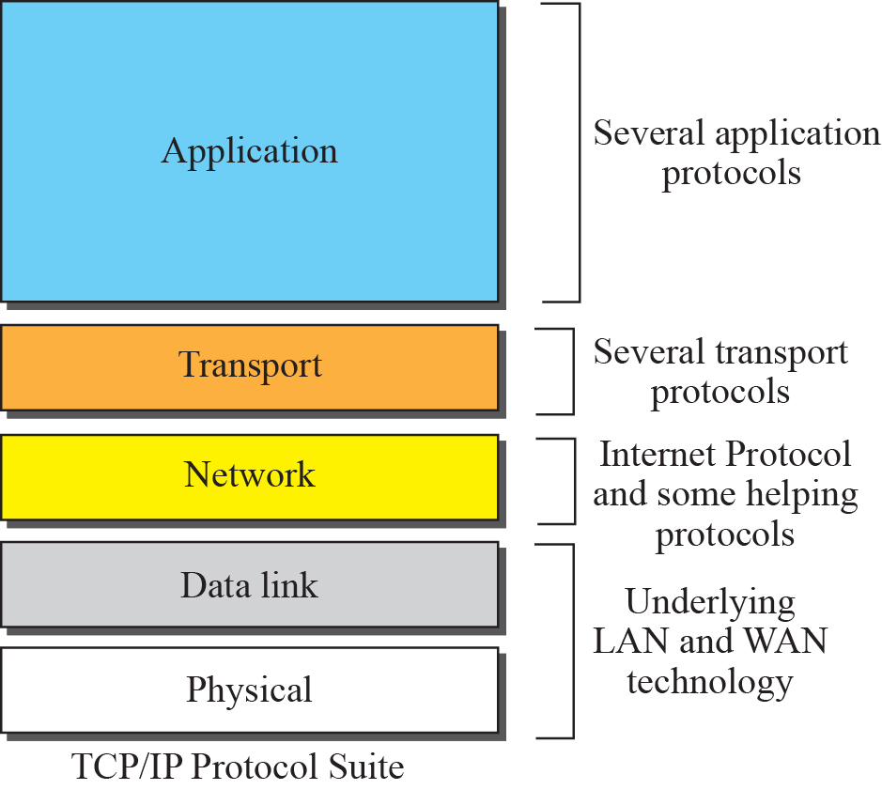
Figure 2.8 TCP/IP and OSI model

Slide 16
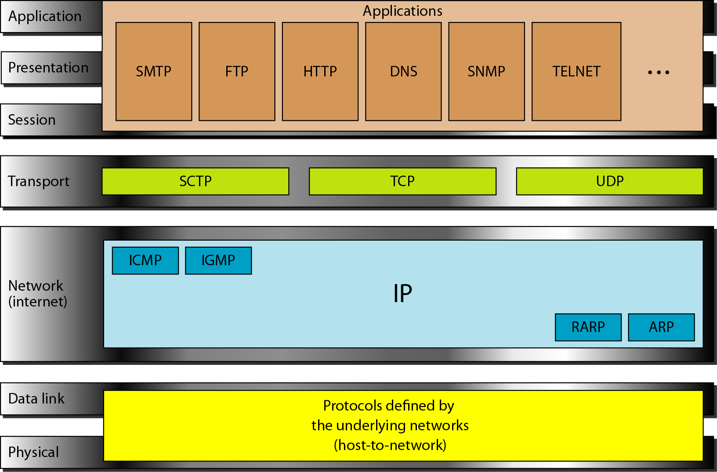
Figure 2.16 TCP/IP and OSI model

Slide 17
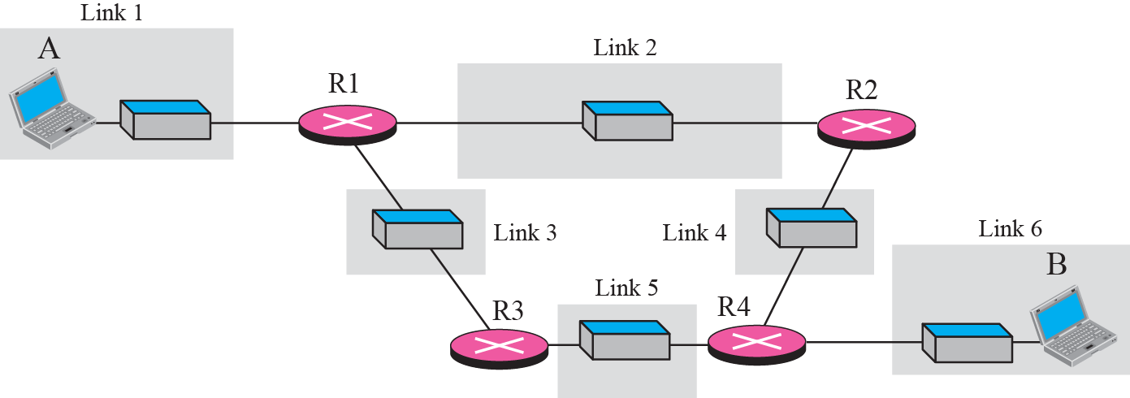
Figure 2.9 A private internet

Slide 18
Figure 2.10 Communication at the physical layer

Slide 19
Note
The unit of communication at the physical layer is a bit.

Slide 20
Figure 2.11 Communication at the data link layer

Slide 21
Note
The unit of communication at the data link layer is a frame.

Slide 22
Figure 2.12 Communication at the network layer

Slide 23
Note
The unit of communication at the network layer is a datagram.

Slide 24
Figure 2.13 Communication at transport layer

Slide 25
Note
The unit of communication at the transport layer is a segment, user datagram, or a packet, depending on the specific protocol used in this layer.

Slide 26
Figure 2.14 Communication at application layer

Slide 27
Note
The unit of communication at the application layer is a message.

Slide 28
2-4 ADDRESSING
Four levels of addresses are used in an internet employing the TCP/IP protocols: physical address, logical address, port address, and application-specific address. Each address is related to a one layer in the TCP/IP architecture, as shown in Figure 2.15.

Slide 29
Topics Discussed in the Section
Physical Addresses
Logical Addresses
Port Addresses
Application-Specific Addresses

Slide 30
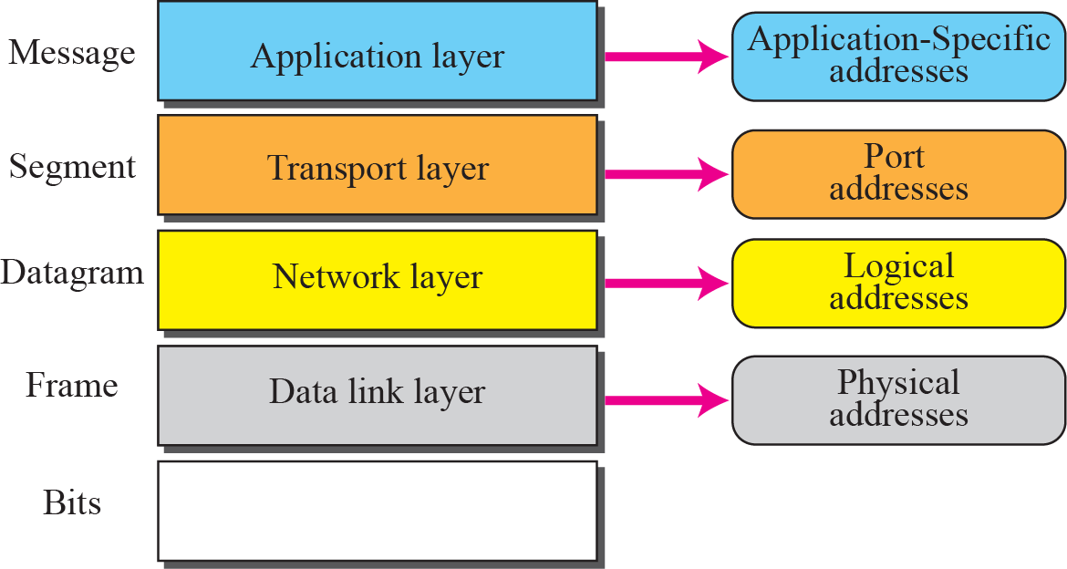
Figure 2.15 Addresses in the TCP/IP protocol suite

Slide 31
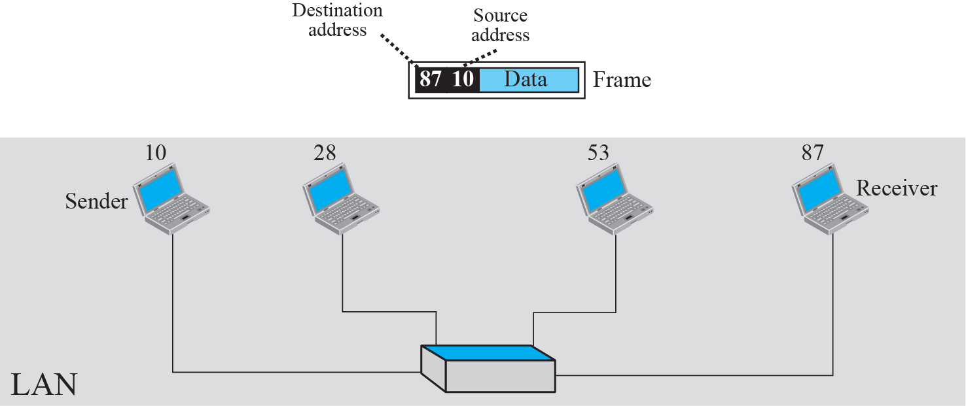
Figure 2.16 Example 2.3: physical addresses

Slide 32
Example 2.4
As we will see in Chapter 3, most local area networks use a 48-bit (6-byte) physical address written as 12 hexadecimal digits; every byte (2 hexadecimal digits) is separated by a colon, as shown below:
07:01:02:01:2C:4B
A 6-byte (12 hexadecimal digits) physical address

Slide 33
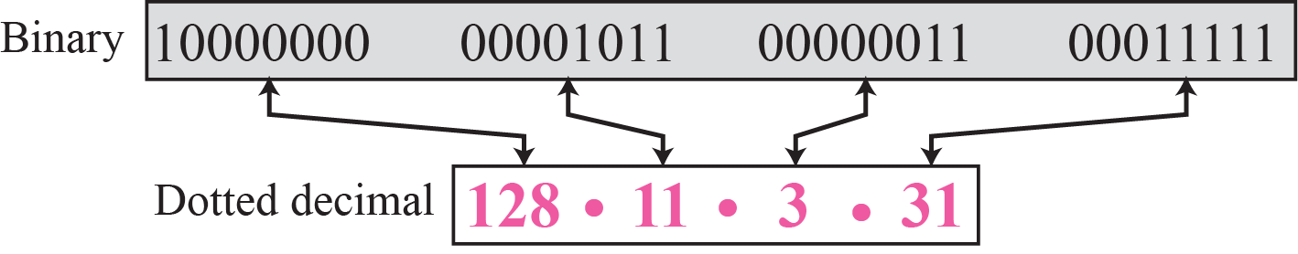
Figure 5.1 Dotted-decimal notation
Note
An IPv4 address is 32 bits long.

Slide 34
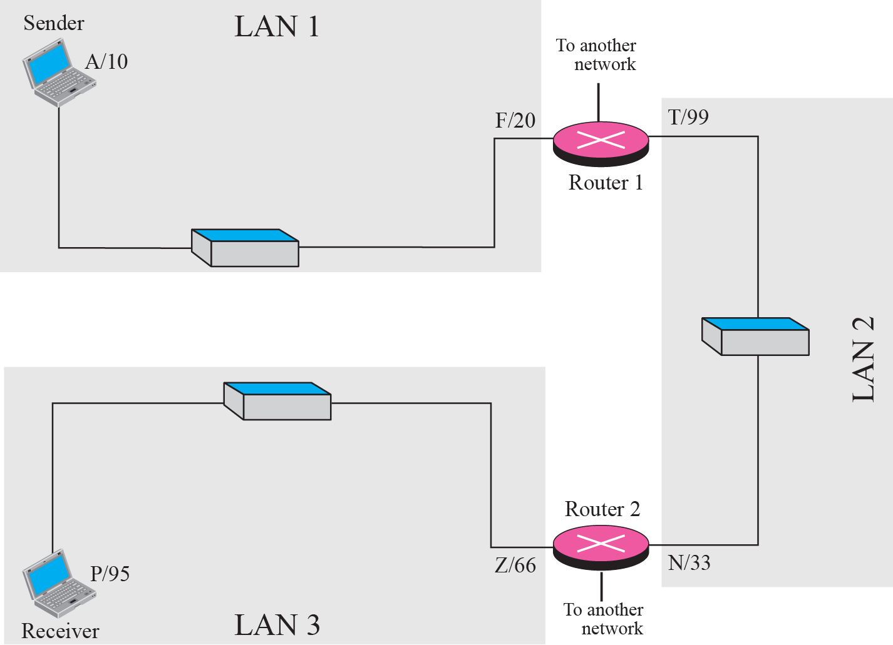
Figure 2.17 Example 2.5: logical addresses

Slide 35
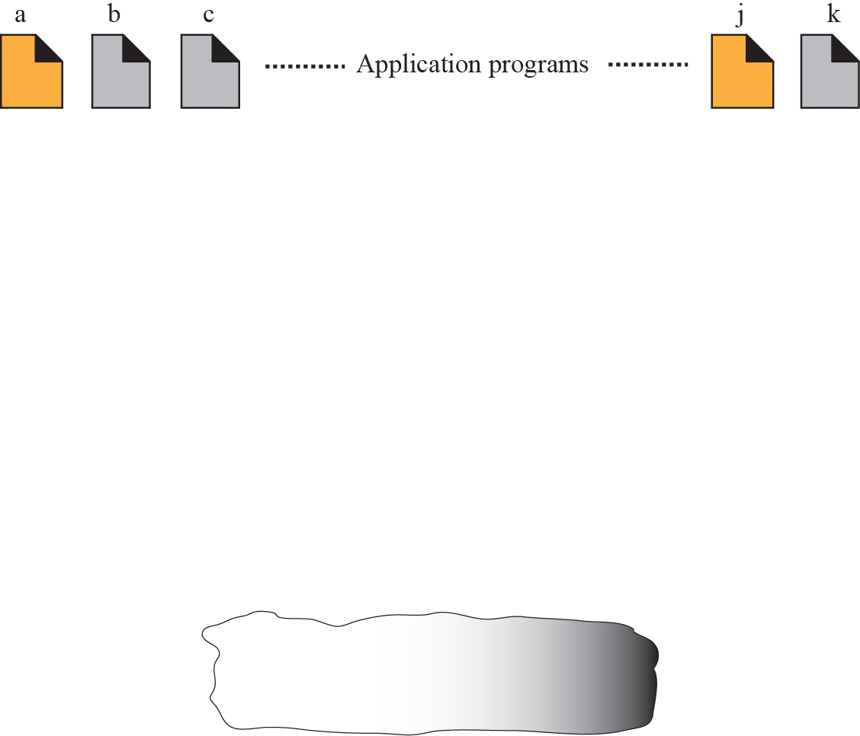
Figure 2.18 Example 2.6: port numbers

Slide 36
Note
The physical addresses will change from hop to hop, but the logical addresses remain the same.

Slide 37
Note
The physical addresses change from hop to hop, but the logical and port addresses usually remain the same.

